Slide 1

Revature Meet & Greet
Advancing Talent and Technology
“The most reliable way to predict the future is to create it” – Abraham Lincoln

Slide 2

What are Meet & Greets?
Meet Client Leaders and Potential Teams.
A way for you to ask questions about the client(s) and team(s).
Platform to ask directly about technologies and impacts teams are making in technology.
Aimed at preparing you for interviews with clients.
Meet & Greet

Slide 3
Introducing Yourself
State your Name, Region, Background, Fun Fact
Please be Brief (less than 60 seconds)

Slide 4
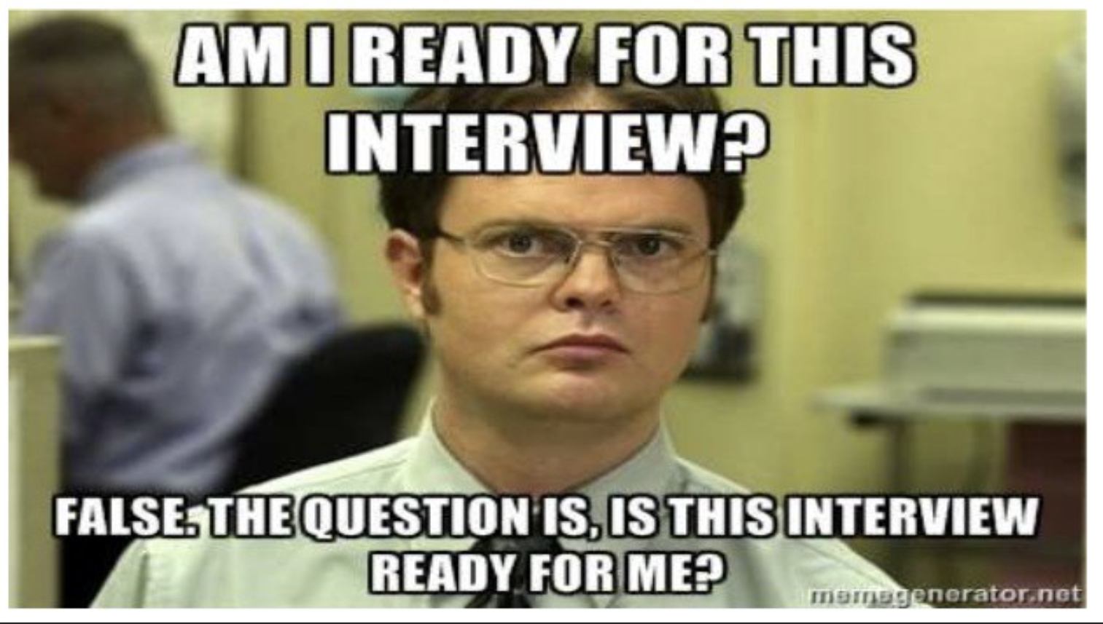
Basic Do’s and Don’ts
DO’s
DON’Ts
Be polite and professional
Prepare a few relevant questions
Ask questions & Participate
Be on video with appropriate lighting
Be on mute unless asking or answering questions
Wear appropriate attire
Be positive
Pay Attention
Take Notes
Ask Revature related questions
PTO, Pay, Relocation, Benefits
How many positions are there
Not all will know
Leave the area while you're on video during the M&G
Drink or Eat During M&G
Take another Call during M&G
Meet & Greet?
Meet & Greet

Slide 5
Sample Questions
When you are ready with your question, please use the Raise Hand feature in Teams and wait to be called upon then Introduce yourself (just your name) then proceed with your question.
We are in our ## week of training while we are learning XYZ, can you tell us what to prepare for the most during our training?
Can you tell us more about your team size?
Are your teams in Daily Stand Ups? If so, how do those look?
Do you participate in Sprints? If so, what is the average of each sprint?
We are working on our certifications; can you tell us more about your cloud environment and what we can expect as a new team member?
I read a bit about ABC Business Unit and was curious about XYZ impact on the team, can you expand on that?
What can best prepare us between if we are selected to join and being onboarded? What would you recommend us looking into?
What advice would you give to someone new to the Team like myself, in order to be successful?
Can you share any tips that you feel we should adopt on day one?
What sort of project documentation exists?
Where do you see the company grow in the next 5 years and is there anything we can do to align ourselves for that?

Slide 6
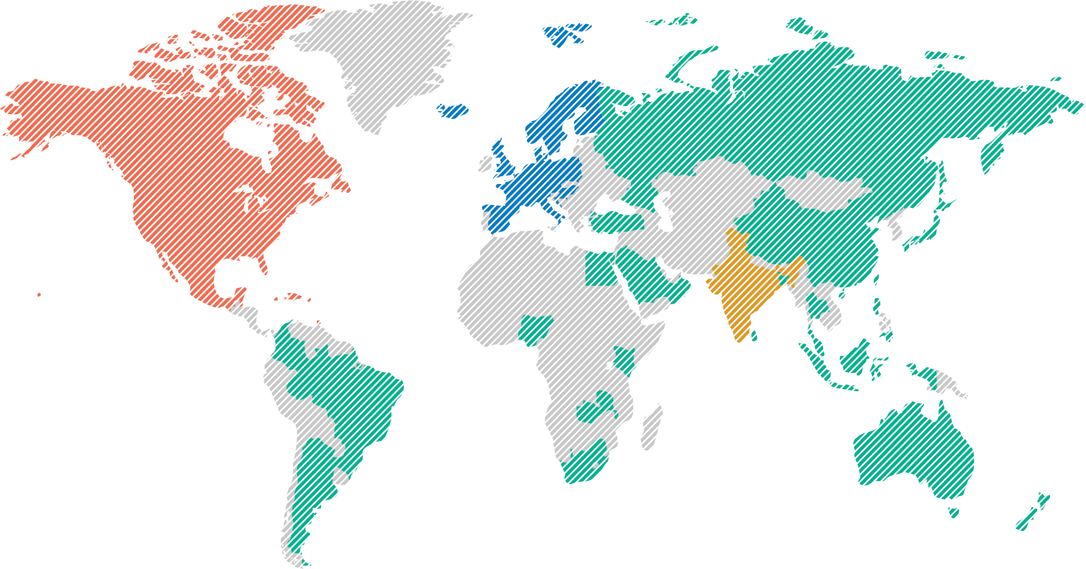
Global Company…
A global company with presence
in 50+ countries
North America
61.4%
Europe
25.2%
Rest of World
10.2%
India
3.2%

Slide 7










Why Infosys
Tools for Career Development
Recognized as Global
Top Employer
World class facilities for further learning
Consistent Revenue growth
of 13-15% per year
Diversified Industry focus
Quick career progression
(Power Programmers)
Industry standard benefits

Slide 8








~ 800 yearly Hires from Revature in Digital technologies
1
#1 hirer of Revature Talents
7500 campus hires in North America
Highly governed relationship
Customized training for Infosys
>5 years of engagement

Slide 9



Infosys services
Experience
Digital Marketing
Digital Experience
Digital Commerce
Infosys Metaverse Foundry
Digital Interactions
Insight
Applied
Data Analytics
Innovate
Blockchain
Engineering Services
Internet of Things (IoT)
Accelerate
Enterprise Agile DevOps
Cloud – Infosys Cobalt
Microsoft Cloud Business
Salesforce
API Economy & Microservices
Digital Process Automation
Oracle
Service Experience Transformation
Application Modernization
Digital Supply Chain
SAP
Workplace Transformation
Assure
Cyber Security
Testing
Application Development and Maintenance
Application Development
Application Maintenance and Support
Domain Consulting
Technology Consulting

Slide 10
Key Timelines (Training to Onboarding)
Training ID | Technology In Demand | Training Start Date | Training End Date | Final Interview Start Date | Tentative Onboarding Dates
2296 | Java | 15-Sep-25 | 10-Oct-25 | 13-Oct-25 | 6-Nov-25
2297 | .NET | 15-Sep-25 | 24-Oct-25 | 27-Oct-25 | 20-Nov-25
2298 | Big Data | 15-Sep-25 | 7-Nov-25 | 11-Nov-25 | 4-Dec-25
2309 | Java | 6-Oct-25 | 7-Nov-25 | 10-Nov-25 | 11-Dec-25
2310 | BA | 6-Oct-25 | 14-Nov-25 | 17-Nov-25 | 11-Dec-25
Delivery Meeting | 7th Oct 2025
Meet & Greet (w/ Client) | 9th Oct 2025

Slide 11

Q & A
Thank you for joining, we know you are just getting started!

Slide 12
Thank You
Gabriel S Kumar
(gabriels@revature.com)
Associate Director – CES
Devi Darshanaa
(devi.darshanaa@revature.com)
Delivery Manager
For More Information
Please feel free to reach –
Private and Confidential: For Internal Use Only

